Slide 1
Deep learning
Why you should start too!

Slide 2
intro
Name: Hairul Imam
Just Graduated Officially unemployed 🙈
Contacts:
ki65559@gmail.com
Github.com/khrlimam
Twitter.com/khrl_imam
T.me/TukangSayurGangRumahPlato
Worked on various software development
Just starting a journey on Deep Learning 😄

Slide 3
Overview
Learning algorithm
How machine learns (via supervised learning)
Basic perceptron
Gradient descent
Backpropagation
Features?
Conv
Filters/kernels
Kernel examples
Kernel as learnable parameters
demo

Slide 4
Most of the code will be written using PyTorch

Slide 5
Various type of learning approaches
Supervised learning
Unsupervised learning
Reinforcement learning
And few others

Slide 6
Various type of learning approaches
Supervised learning
Unsupervised learning
Reinforcement learning
And few others

Slide 7
How machine learns via supervised learning

Slide 8
most of the learning process on deep learning is done by computing gradient

Slide 9
What is gradient?

Slide 11



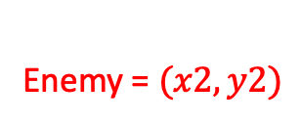
Hero =$(x1, y1)$
Enemy = $(x2,y2)$
$$mx+b$$
Line Equation
(x2,y2)
Gradient = m = $\frac{y2−y1}{x2−x1}$
(x1,y1)
Gradient also often called slope,
meaning how steep the line will rises each $x$ changes ($\frac{rise}{run}$).

Slide 12
unfortunately! World never been that straight!

Slide 13
Back in the day when gradient descent was a shiny toy!

Slide 14
Single layer neuron

Slide 15
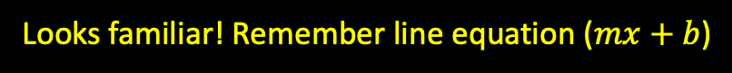
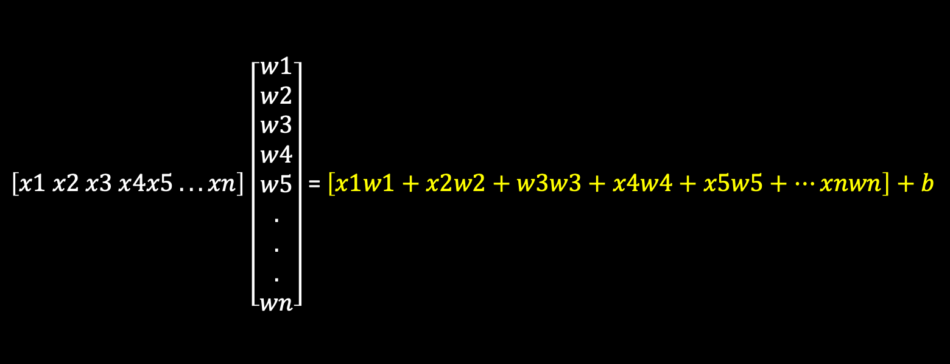
The operation behind single layer neuron
$\left[x1 x2 x3 x4x5 . . . xn\right]$ $\left[\begin{aligned}w1 \\ w2 \\ w3 \\ w4 \\ w5 \\ . \\ . \\ . \\ wn\end{aligned}\right]$ = $\left[x1w1+x2w2+w3w3+x4w4+x5w5+…xnwn\right]+b$
Looks familiar! Remember line equation ($mx+b$)

Slide 16



But to get the correct (best aprox) we need to compute the gradient but unlike computing gradient in the linear equation
$$w_{j}=w_{j}+ ∆w_{j}$$
$$∆w_{j}= η({target}^{i}−{output}^{i})x_{j}$$
Where $η$ is learning rate

Slide 17
That is one layer perceptron how about layers of layers?

Slide 18
how to set the right params for this layers???

Slide 19
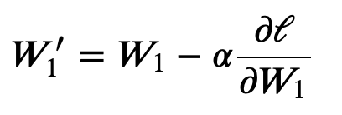
Back prop come on rescue!

